Slide 1


GAN-WGAN 生成实验
------基于Alexnet
汇报人：洪火俊

Slide 2

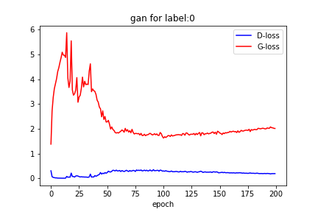
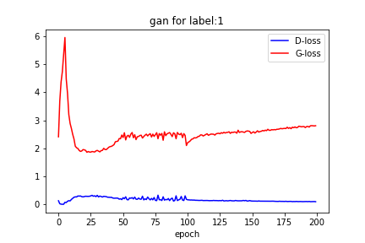
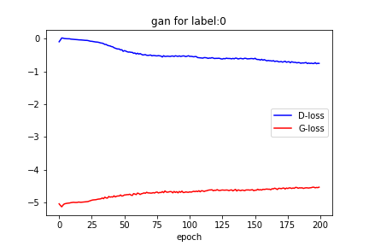
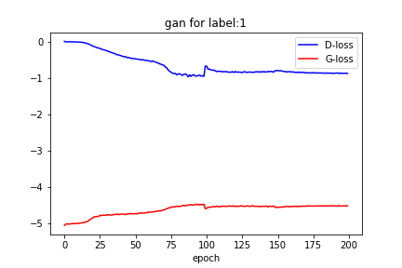
Train-loss
Label = 0 Label = 1
GAN WGAN

Slide 3
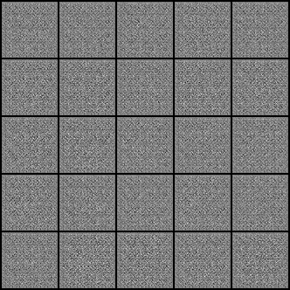
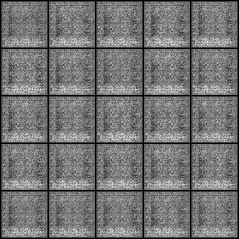
Label=0
Num = 1583
GAN
WGAN

Slide 4
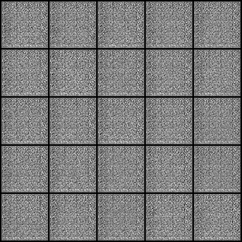
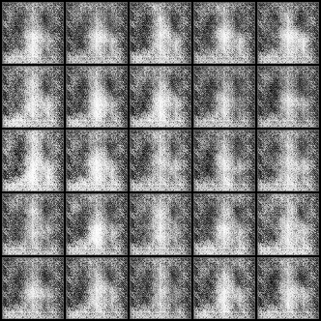
Label=1
Num = 4273
GAN
WGAN

Slide 5
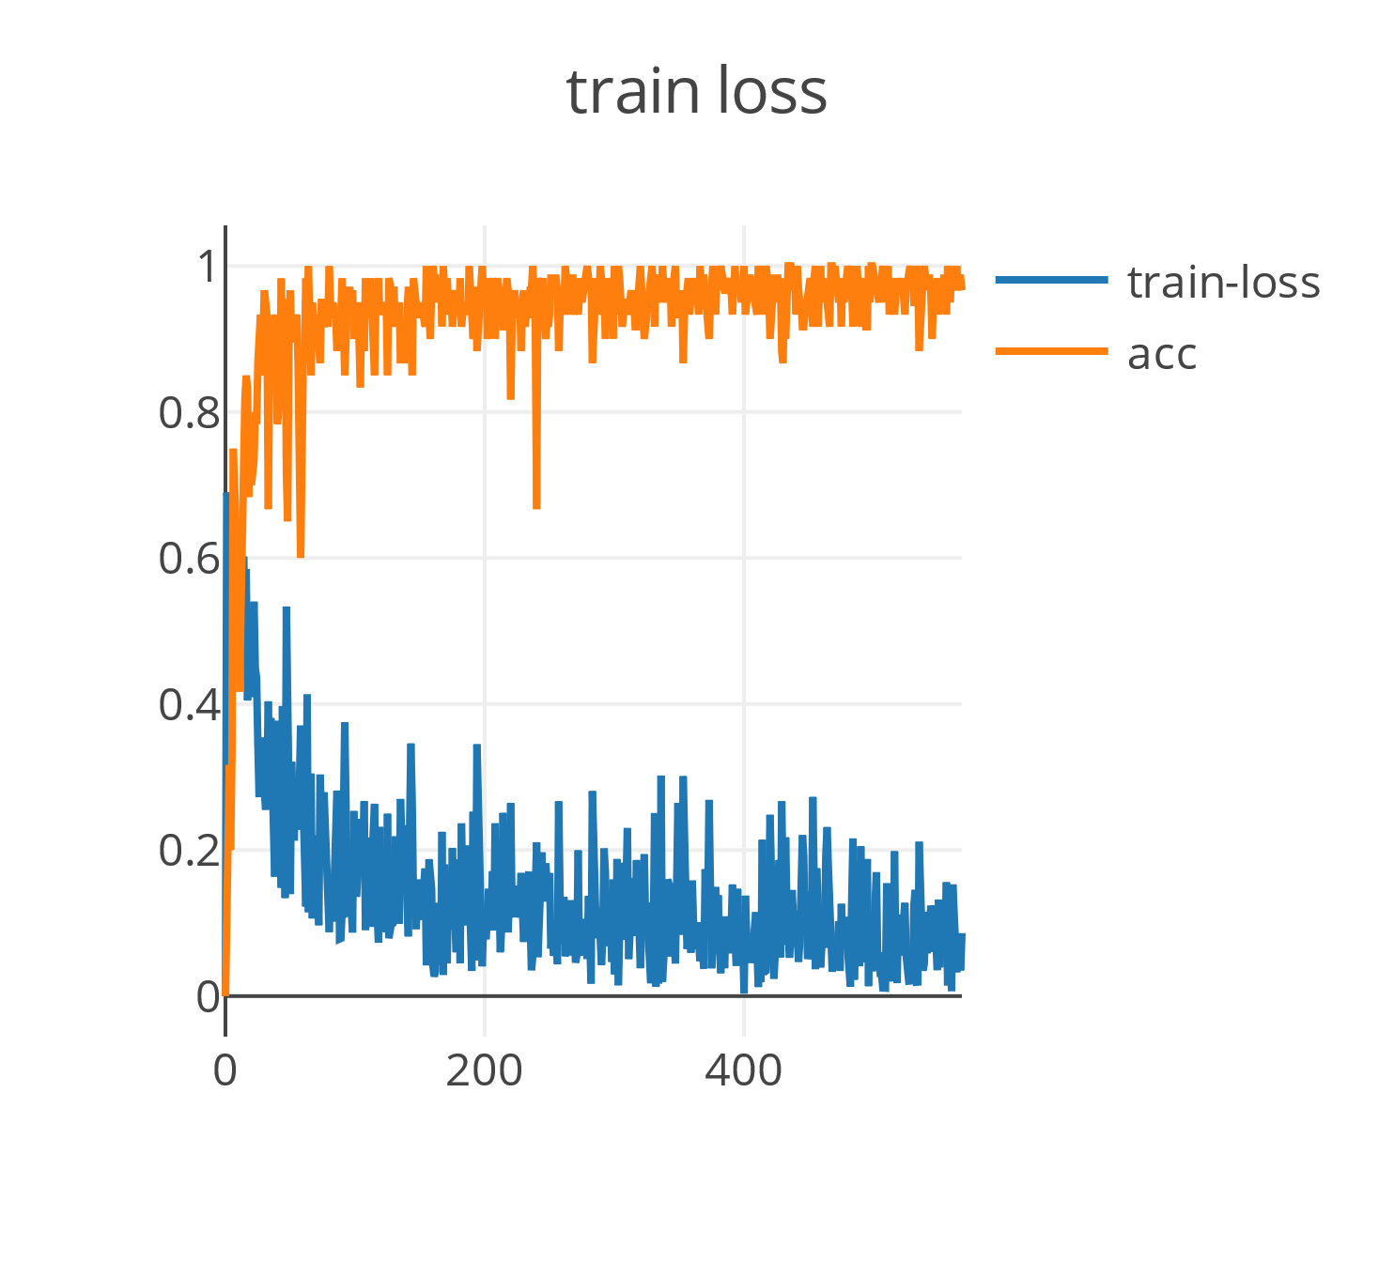
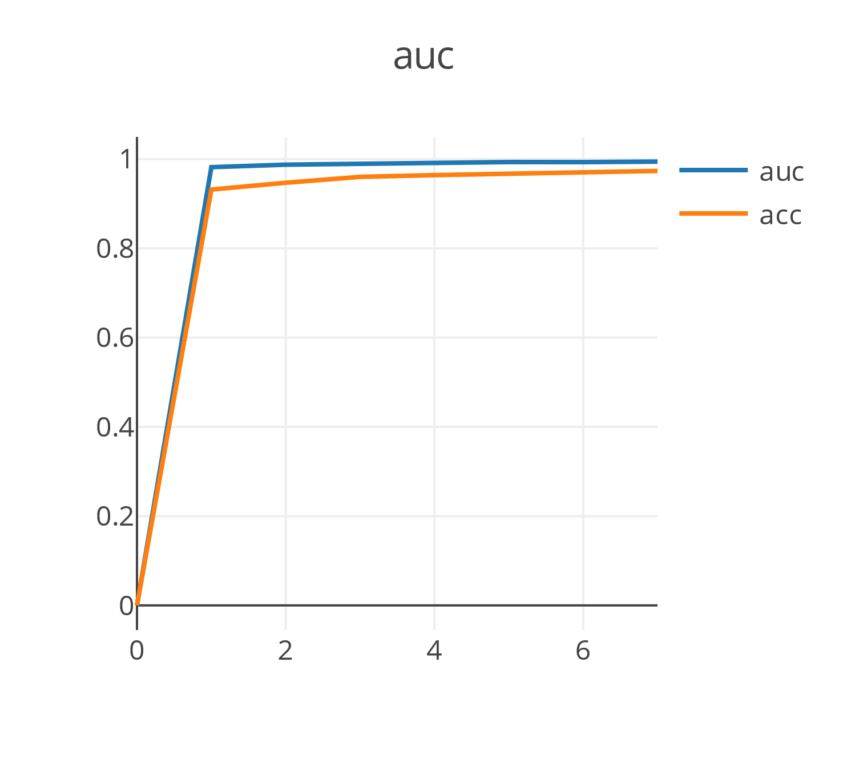
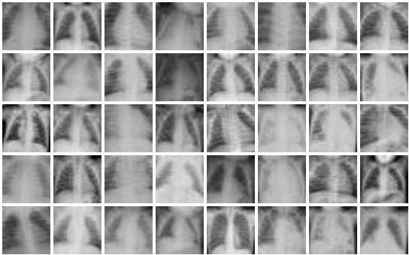
Task 1
[1 0 1 1 1 1 1 0
0 1 1 1 0 0 0 1
1 0 1 1 1 1 1 1
1 0 1 1 1 1 1 0
1 1 1 0 0 1 1 1]

Slide 6
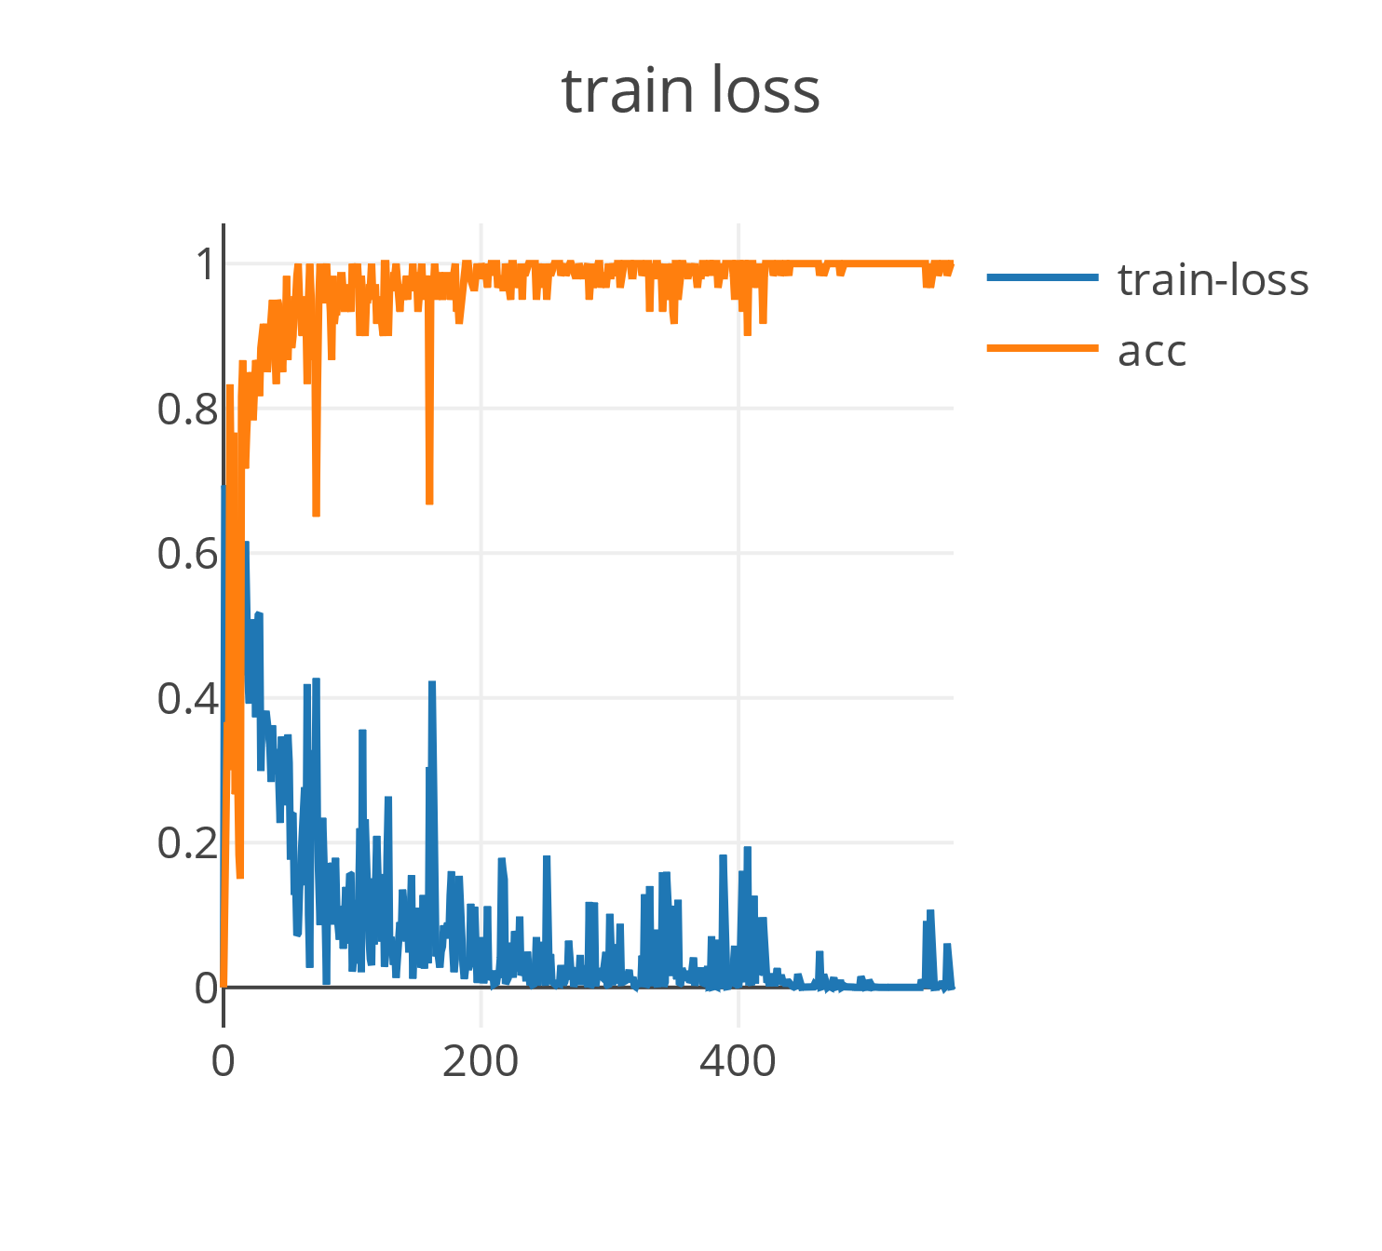
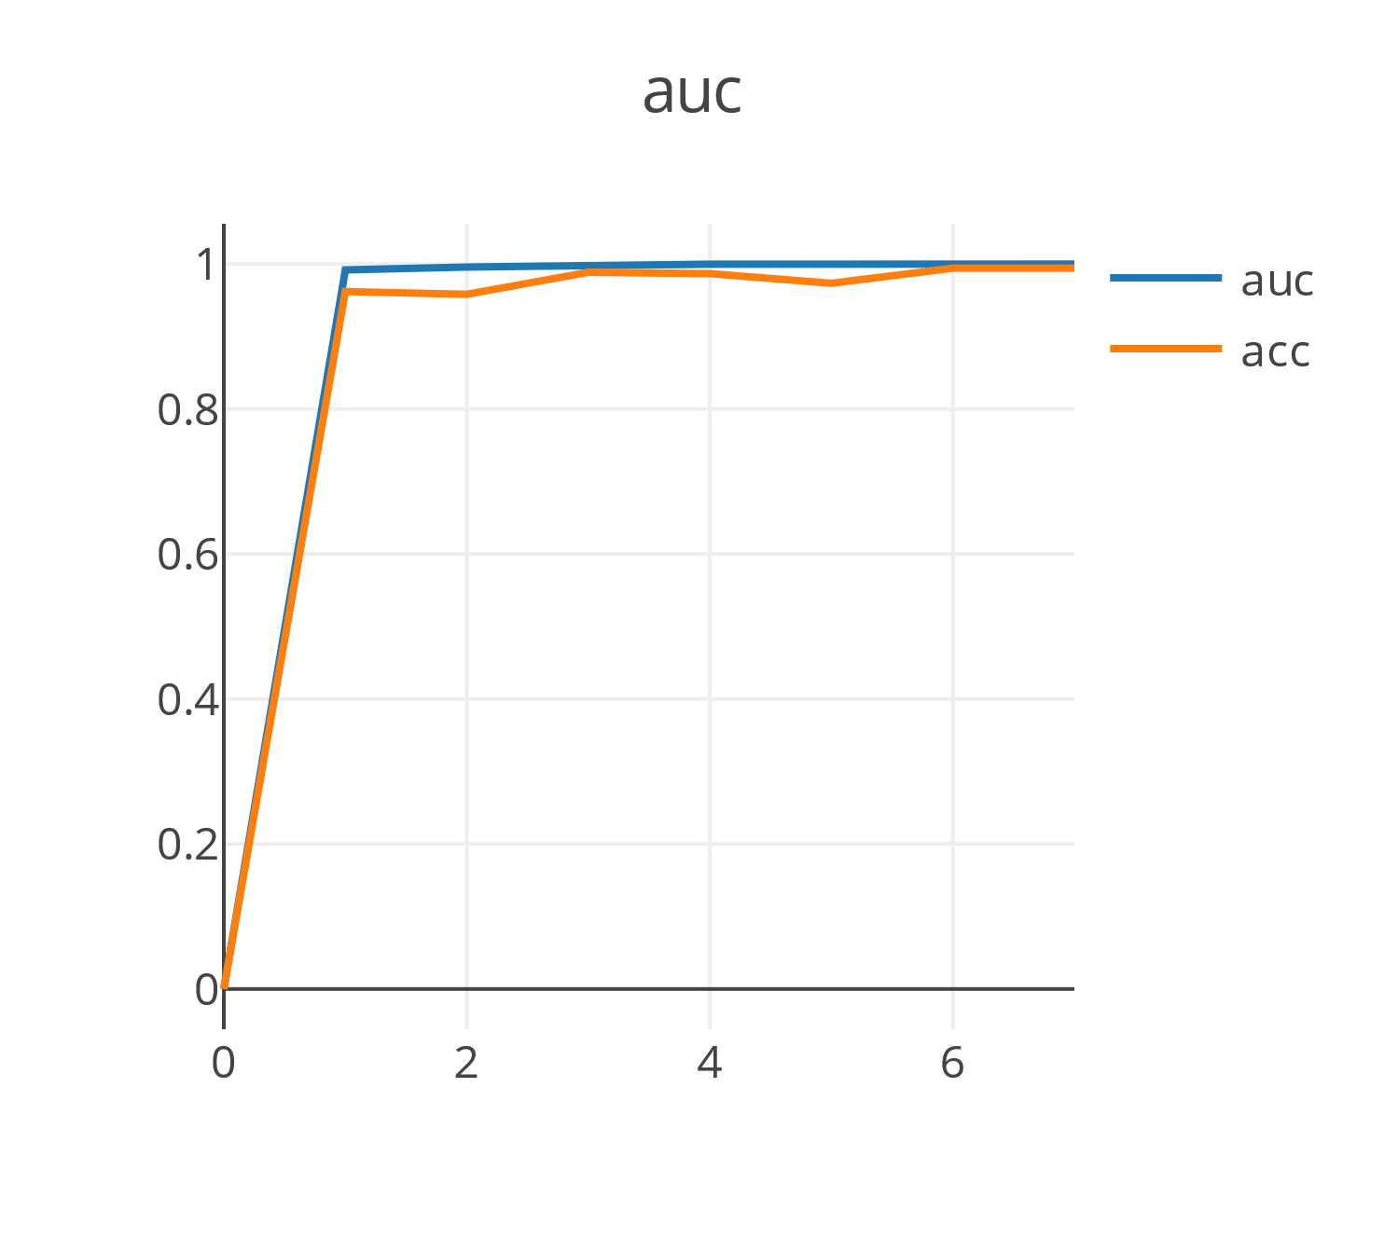
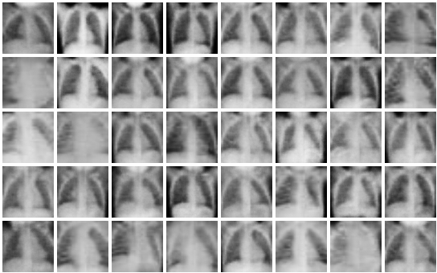
Task 2: by GAN
[0 1 1 1 1 1 1 1
1 1 1 0 1 1 0 1
1 1 1 1 1 1 0 1
1 0 0 1 1 1 1 1
1 1 1 1 1 1 1 1]

Slide 7
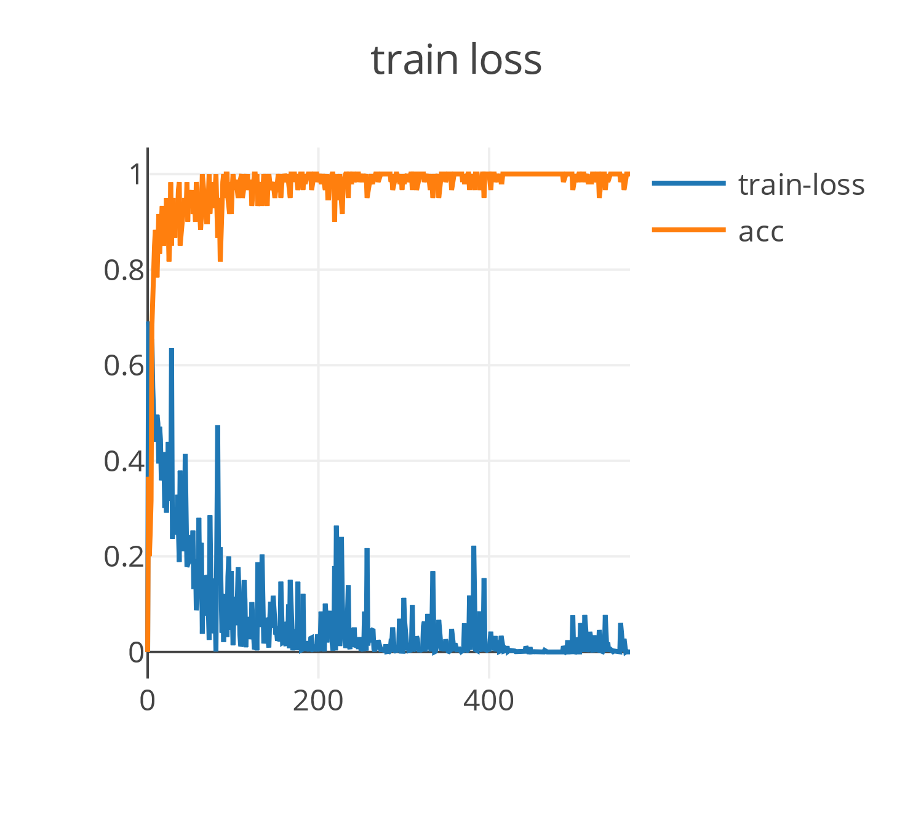

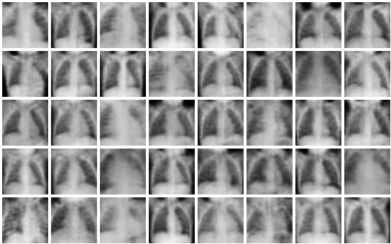
Task 2: by WGAN
[0 1 1 1 1 0 1 0
1 1 0 0 1 1 1 1
1 1 1 1 1 1 1 1
1 1 1 0 0 0 1 1
1 1 1 0 1 1 1 1]

Slide 8
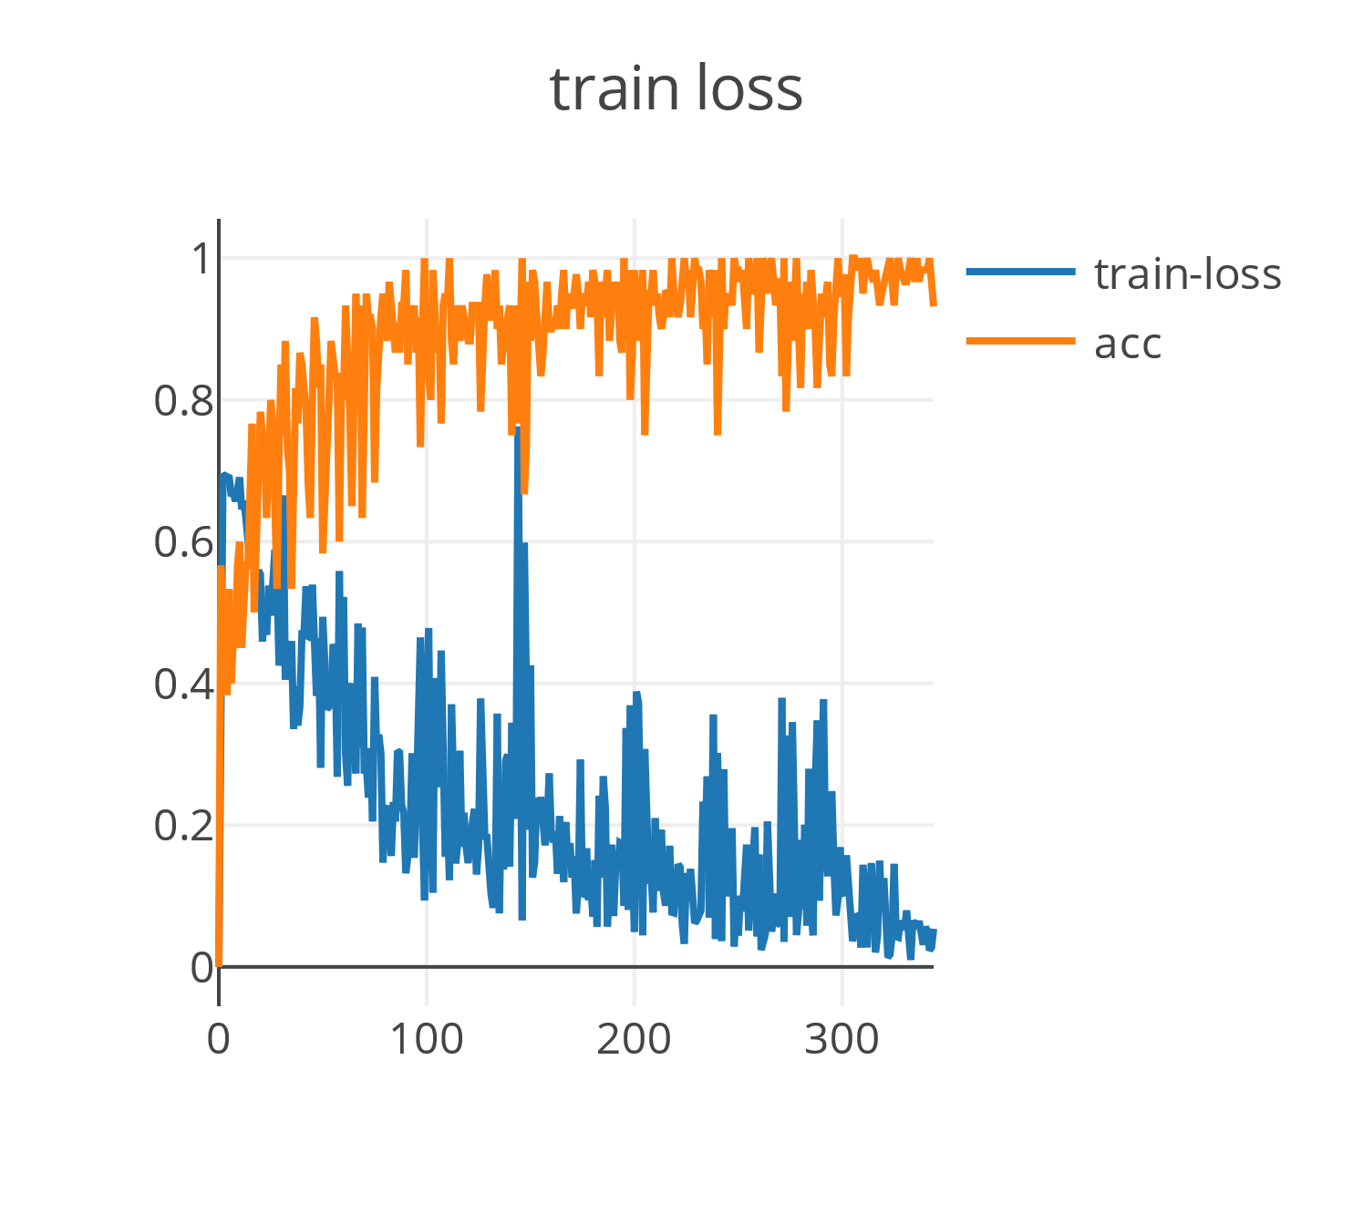
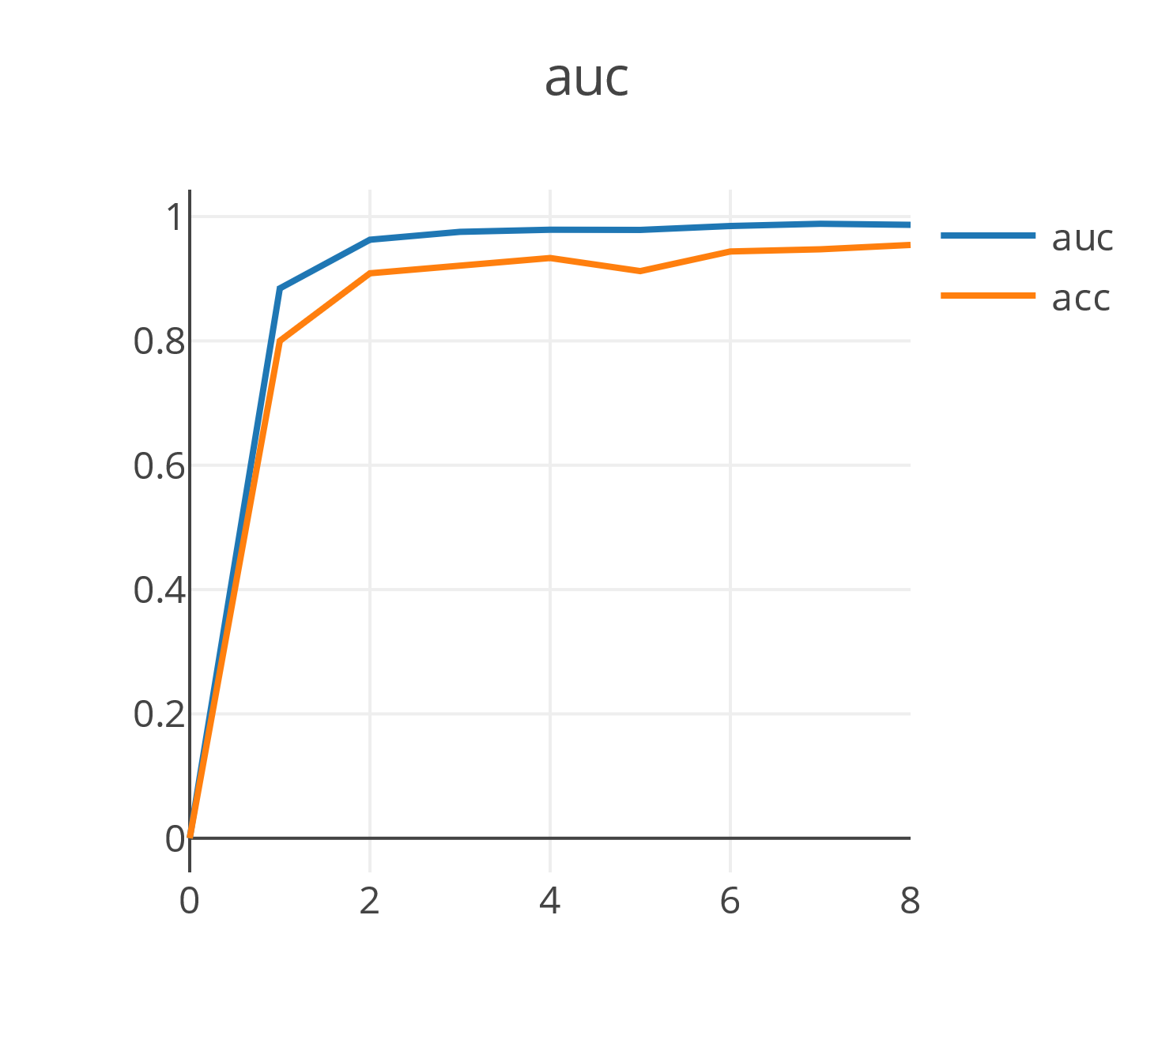
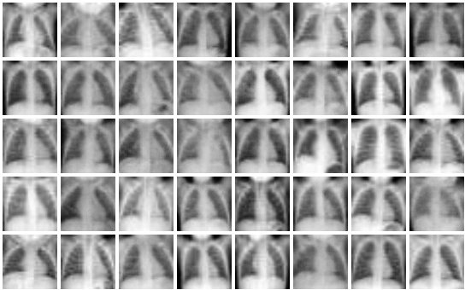
Task 3: by GAN
[1 1 1 0 0 1 0 0
0 0 0 0 0 0 1 1
1 0 0 0 0 1 1 1
1 0 1 0 1 0 1 0
1 1 0 1 1 0 1 1]

Slide 9
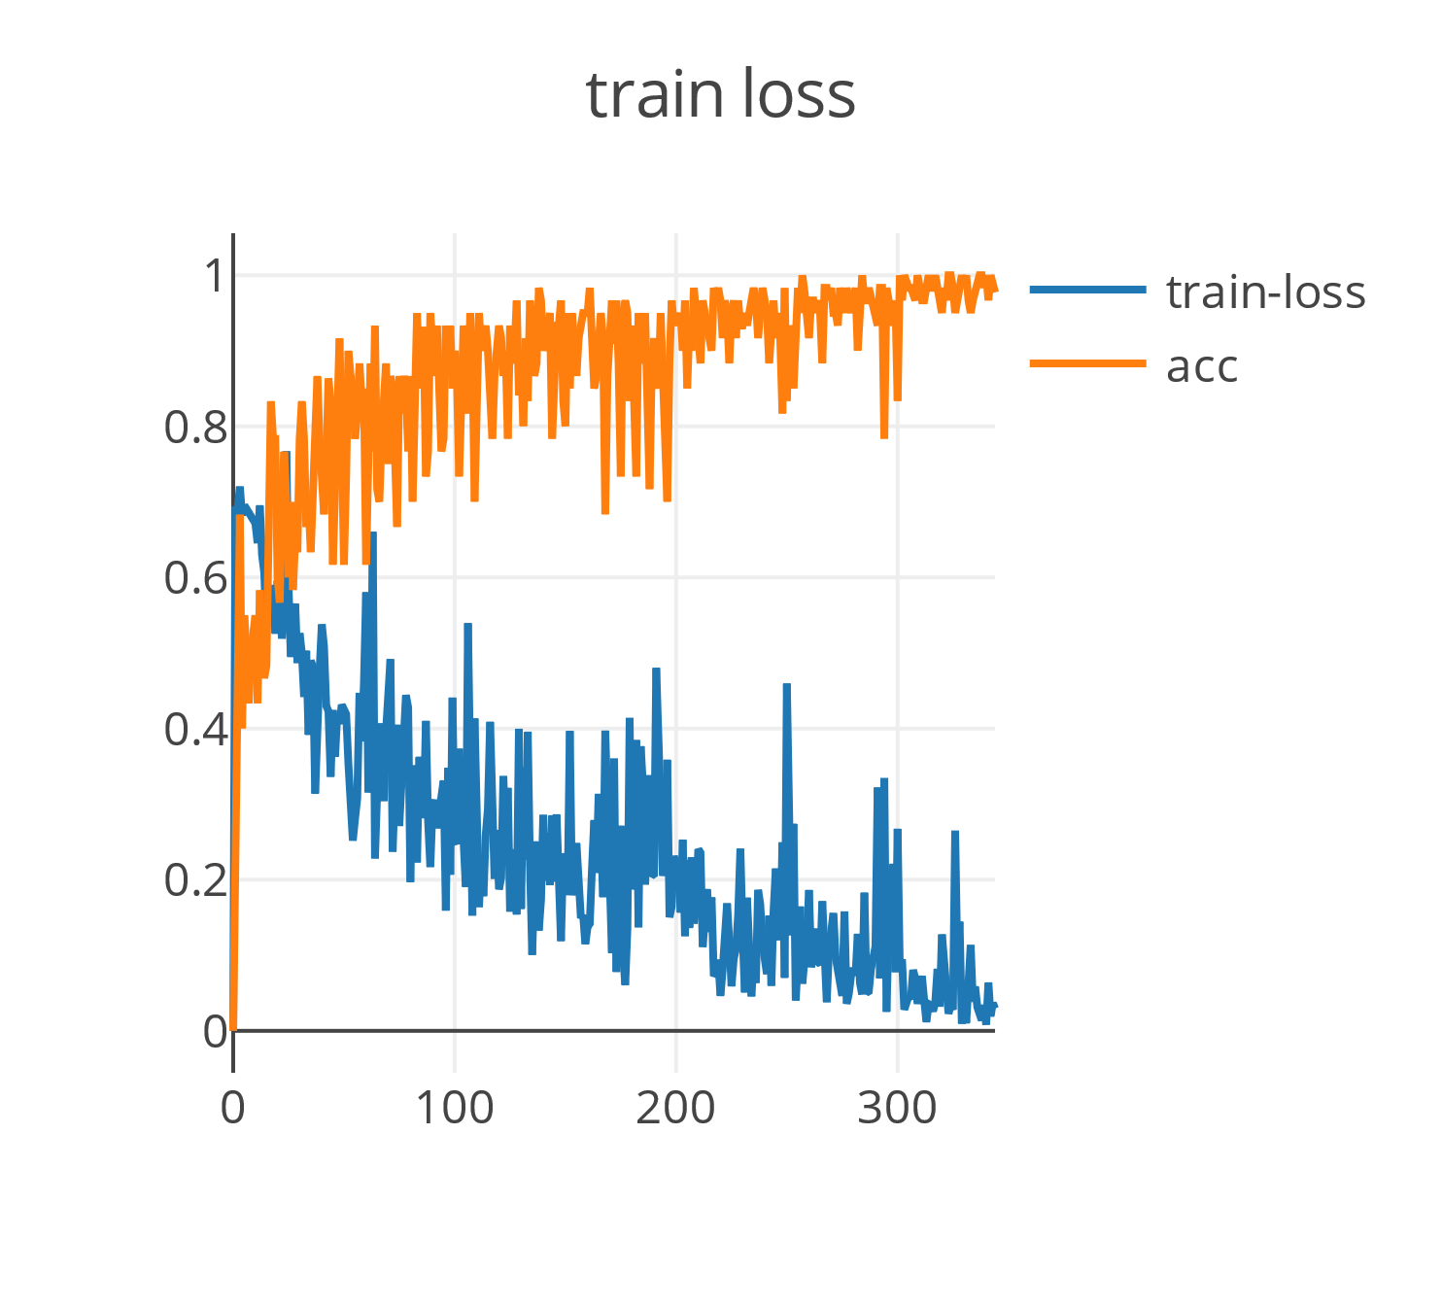
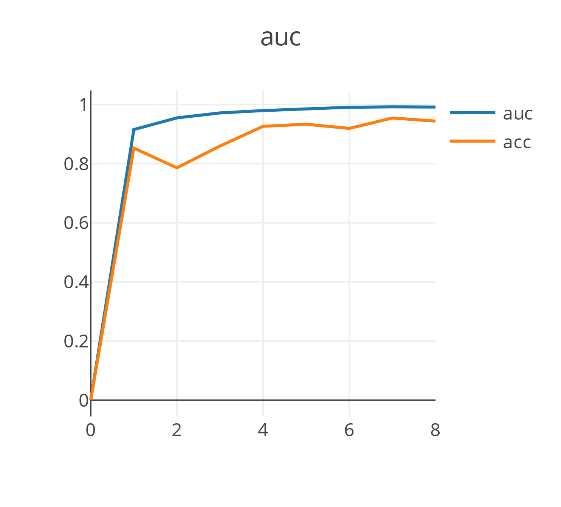
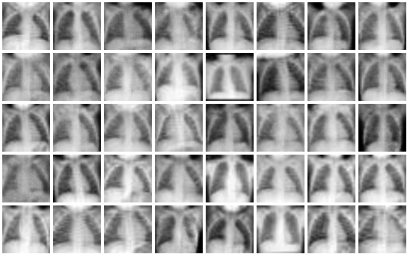
Task 3: by WGAN
[1 0 0 0 0 1 0 0
0 0 0 1 1 1 0 0
1 0 1 1 0 0 0 0
0 1 1 0 1 1 1 1
1 1 1 0 1 1 1 1]

Slide 10
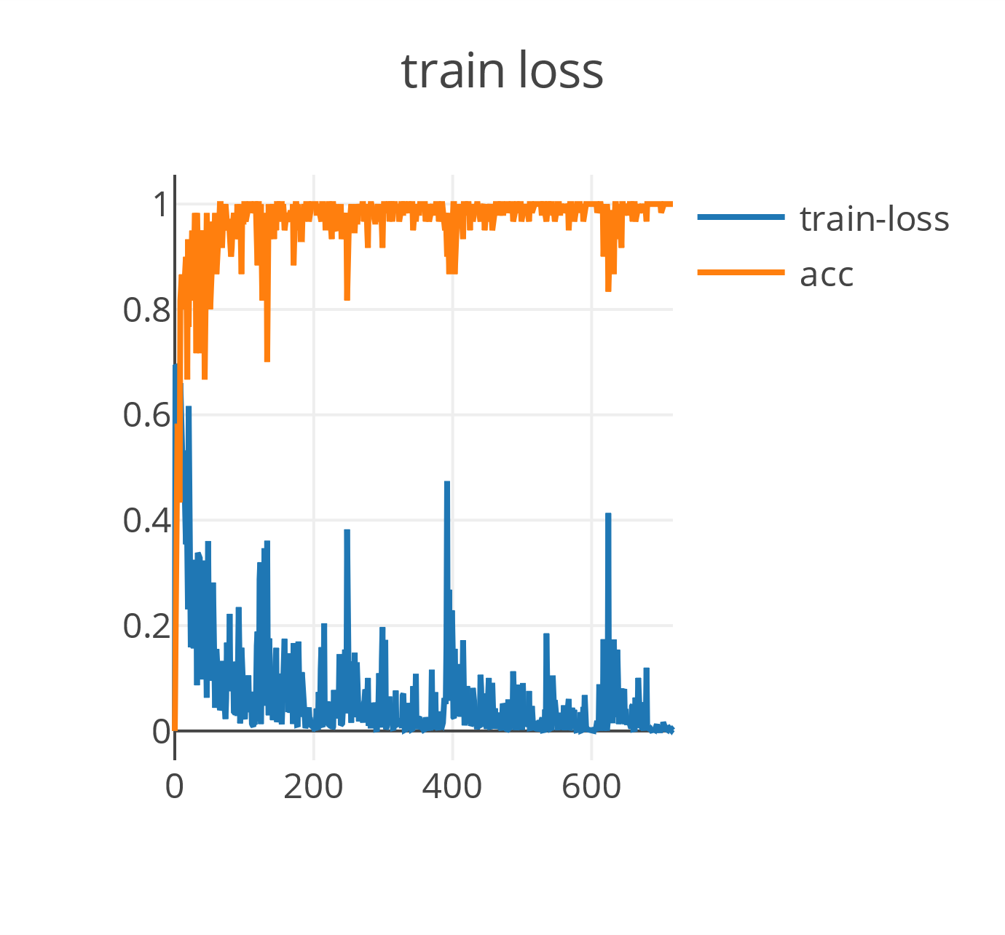
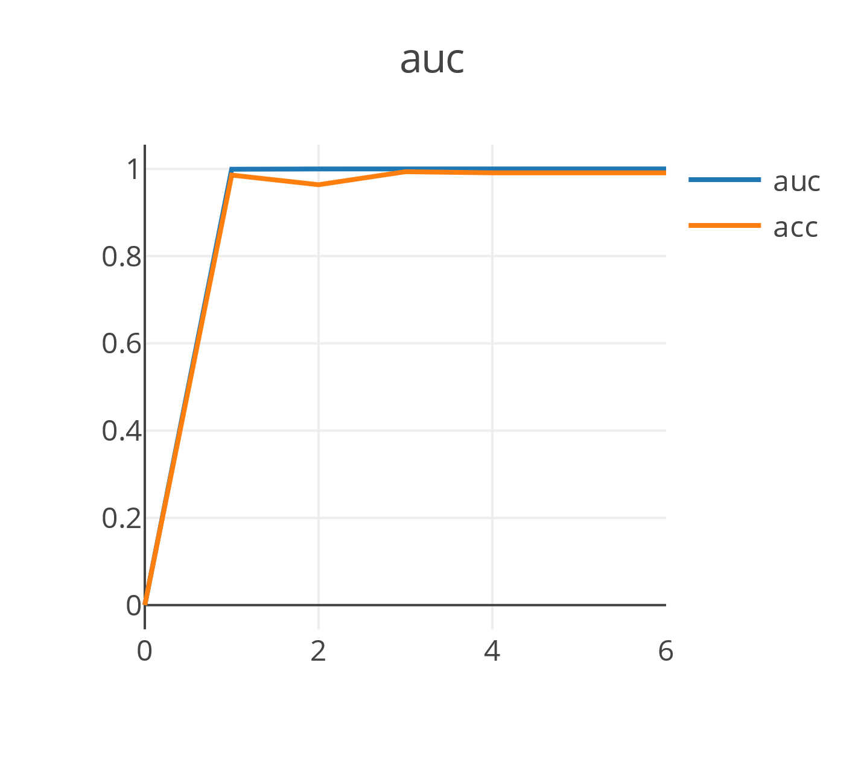
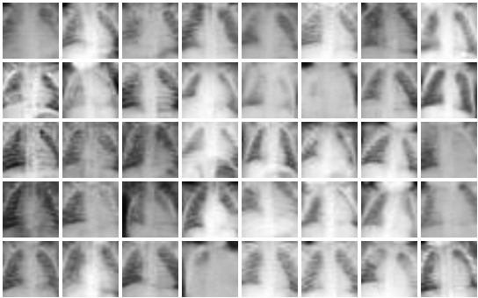
Task 4: by GAN
[0 1 1 1 1 1 0 0
0 0 1 0 1 1 0 0
0 1 0 1 0 0 1 1
0 1 1 0 1 1 1 1
1 0 0 1 0 0 1 0]

Slide 11
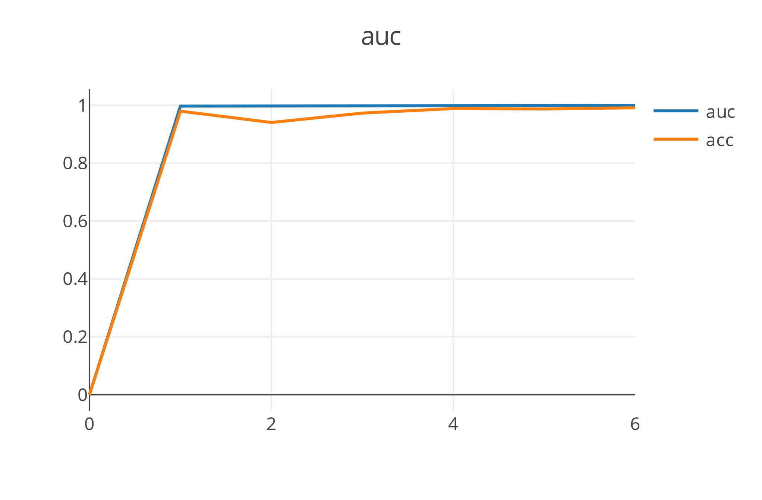
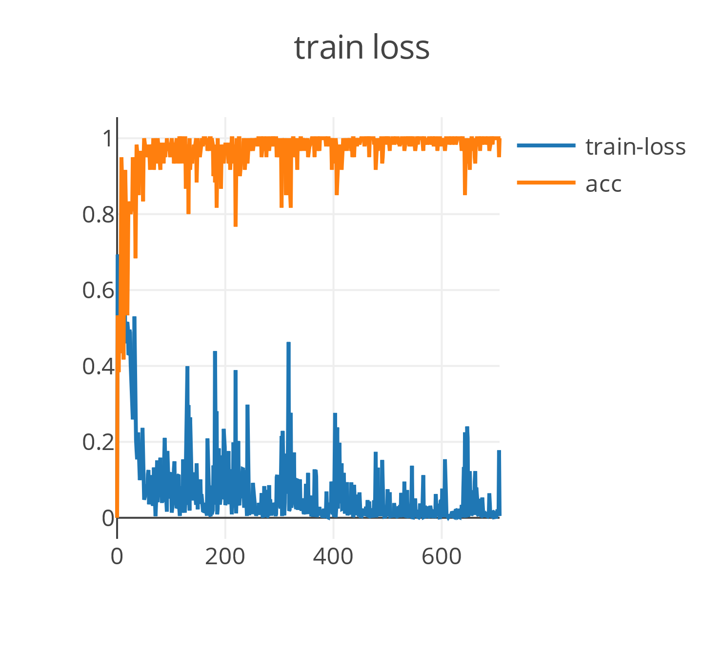
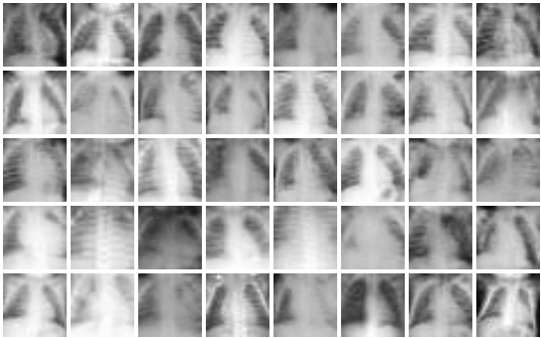
Task 4: by WGAN
[0 1 0 1 0 0 1 0
1 0 0 0 1 0 0 1
0 1 1 0 0 1 0 0
1 1 0 1 1 0 0 0
1 1 0 1 0 1 0 1]

Slide 12
The End!

